Slide 1


cranky coders_presents
Problem Statement
A digital wallet is a software application that allows users to store, send, and receive digital currencies or digital assets. To transact using e-RUPI, a digital wallet will need to be integrated with the e-RUPI payment system. The digital wallet will be used to facilitate transactions between the user's e-RUPI account and other payment systems.
Page 1/20..

Slide 2





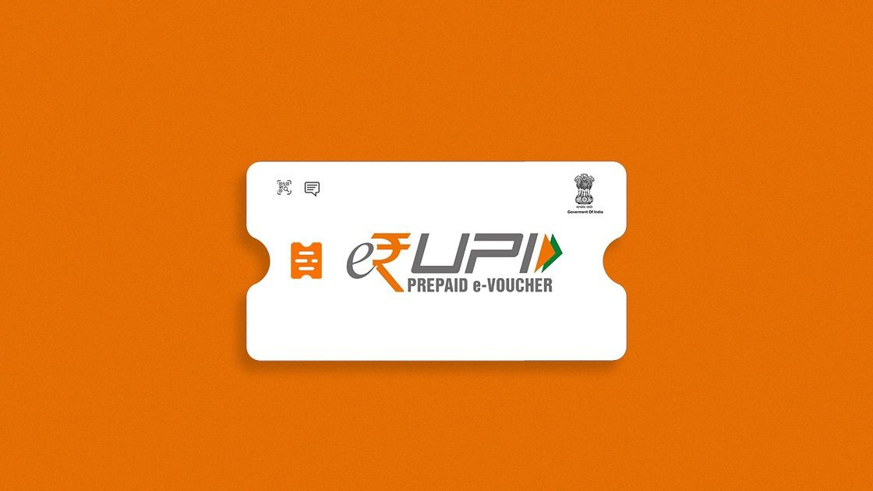
WHAT IS
?
E-Rupi is a digital payment solution introduced by the Government of India.
It is a prepaid, person and purpose-specific cashless e-voucher.
Page 2/20..

Slide 3



GOVERNMENT TO USER FLOW
Government
E-Rupi voucher
Farmer
Page 3/20..

Slide 4


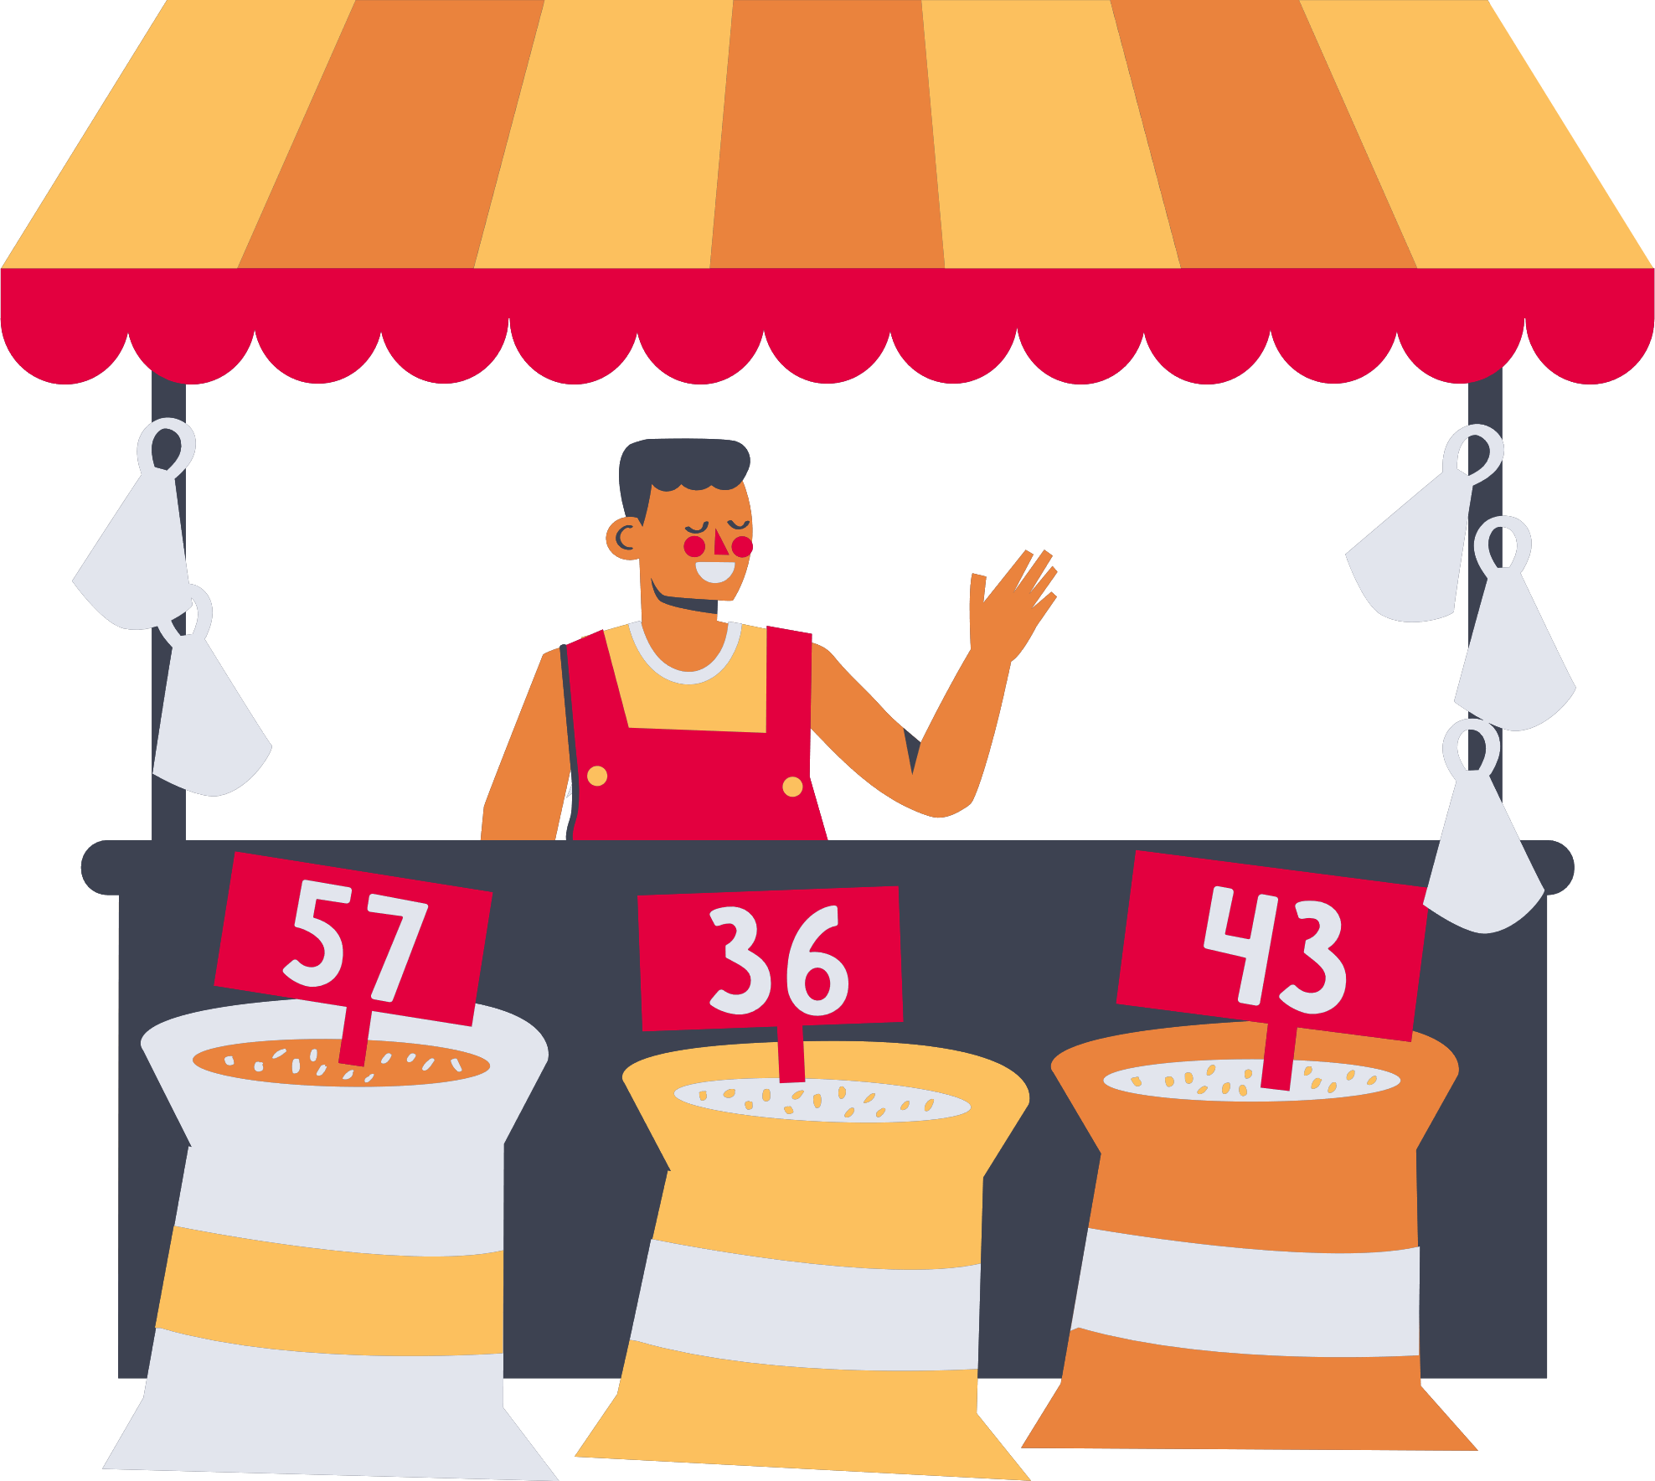


REDEMPTION OF E-VOUCHER
Beneficiary
Merchant
Page 4/20..

Slide 5





CORPORATE TO EMPLOYEE FLOW
Education
Scholarships
Employee
Benefits
CORPORATES
(sponsors)
Maternity
Benefits
Insurance
Page 5/20..

Slide 6



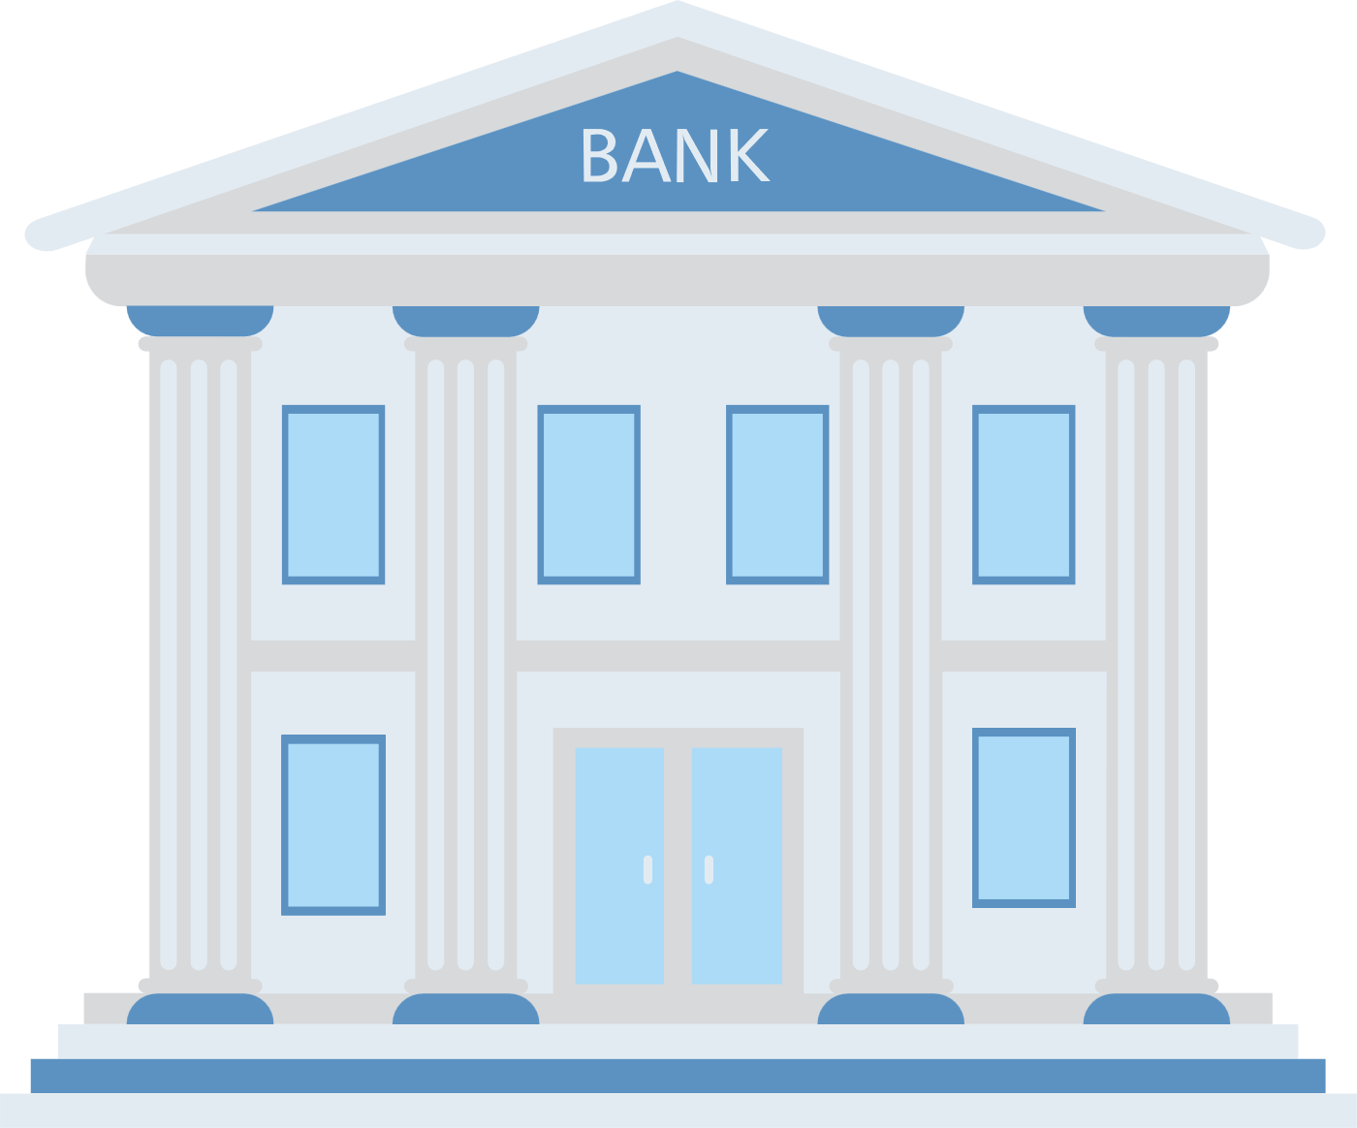

[Sponsors]
ISSUER FLOW
[Issues Vouchers]
Corporates
Government
[Validates Vouchers]
Bank
Page 6/20..

Slide 7



LIMITED FEATURES of E-RUPI
Offline transactions
Manual requests to banks for issuance of E-Rupi Voucher
No platform for govt or corporate to request and distribute vouchers.
Page 7/20..

Slide 8

our solution:
?
An e-rupi voucher ecosystem.
A solution for users and merchants.
Page 8/20..

Slide 9



Where do we come in?
Benefeciaries:
Farmers &
Amex Employees
Issues Vouchers
Sponsors
Amex/ Corporate
Validates Vouchers
Bank
Page 9/20..

Slide 10

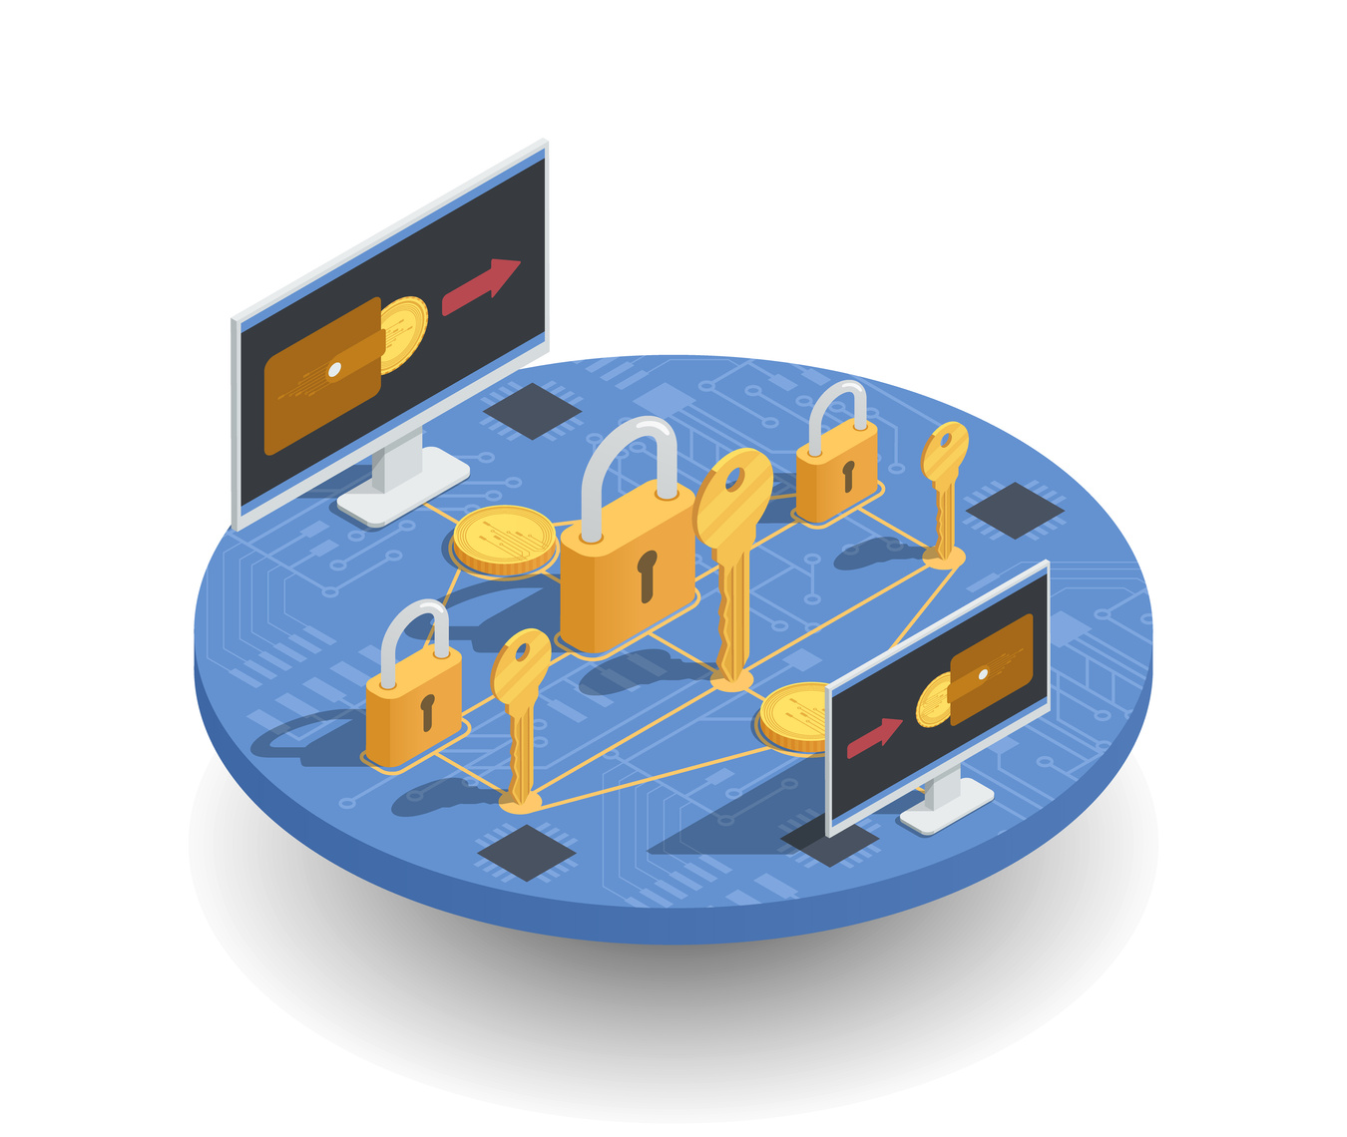
SOLUTION
Security
Digitizing transactions
Tracking Payments
Initiate Transactions
Transaction Confirmation : 2 Factor Authentication
Data encryption : bcrypt library ( Blowfish encryption algorithm)
Authentication : JWT tokens (RSA using SHA256)
Page 10/20..

Slide 11




IMPACT METRICS
Transaction volume
Tracking of voucher
Purpose analysis
User engagement
Page 11/20..

Slide 12
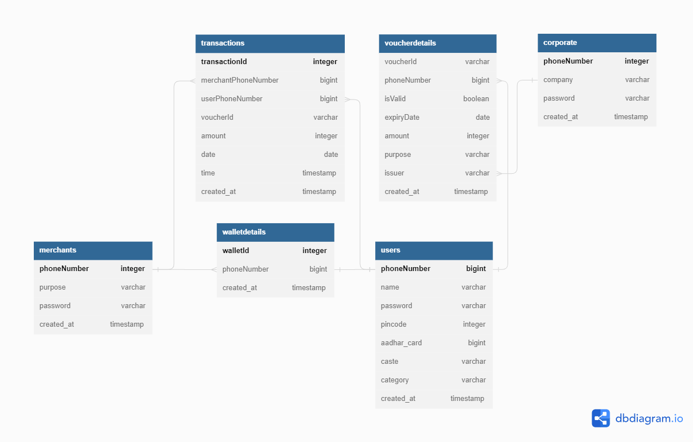
Database Schema
Page 12/20..

Slide 13
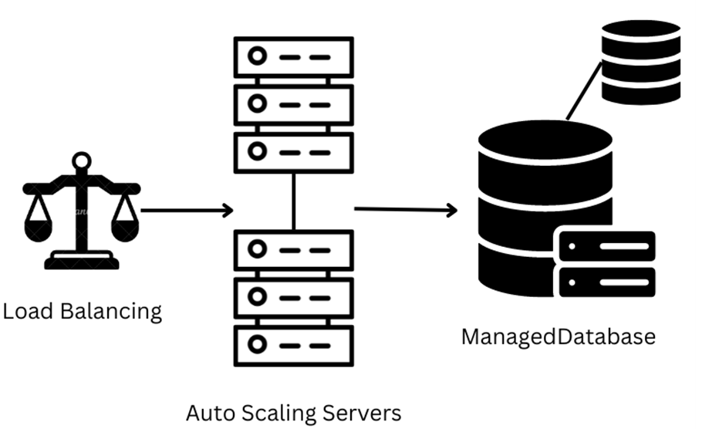
Deployment Architecture: High availability
Page 13/20..

Slide 14


FUTURE SCOPE
Globalization of vouchers
Individual Sponsors
By forming partnerships with international payment service providers, financial institutions, or technology companies that have a global presence.
Easy donations ensuring money reaches the intended person fir the specific cause.
Page 14/20..

Slide 15
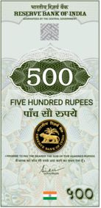
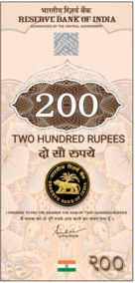
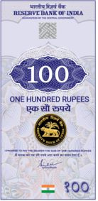
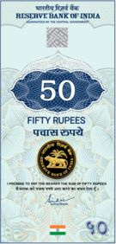
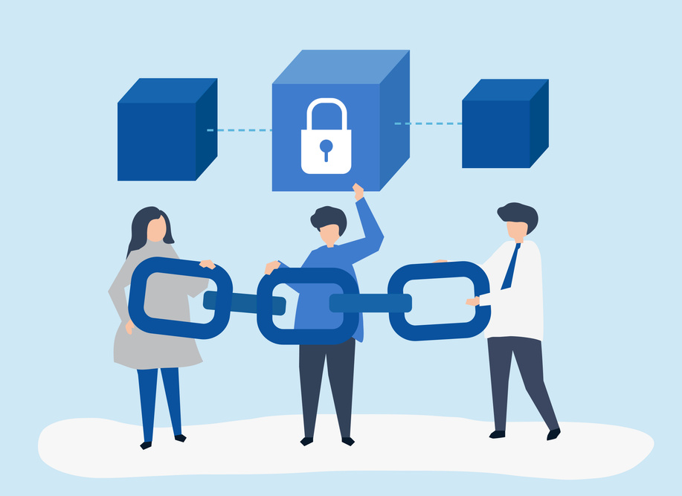
Going Forward...
Allow transactions using digital currency
Our cutting-edge platform can seamlessly integrate with central bank digital currencies (CBDCs) in the near future, ensuring swift and secure transactions in the digital economy. With our digital wallet, you'll have the power to conveniently store, manage, and transact with CBDCs directly.
Blockchain applications
Smart Contracts: Create and issue vouchers automatically based on predefined conditions.
Page 15/20..

Slide 16





TECH STACK
Page 18/20..

Slide 17
Thank you!!!
For your attention

